Slide 1
Unix Commands(II) and Filesystem
Instructor: Li Feng
Capital University

Slide 2
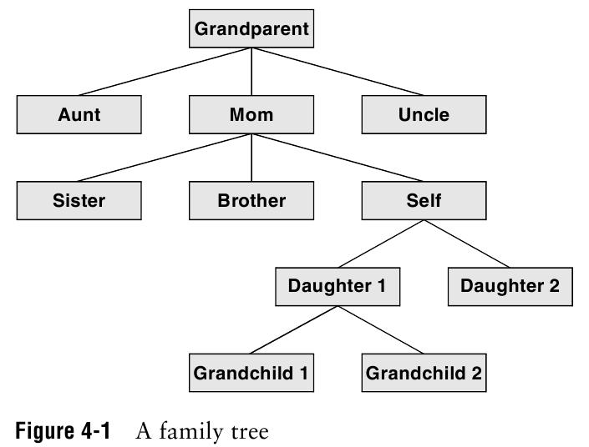
Notes:
A hierarchical structure frequently takes the shape of a pyramid. Tracing the family’s lineage gives us an example of a family tree.
Linux filesystem is called a tree. It consists of a set of connected files and allow you find any particular one easily.

Slide 3
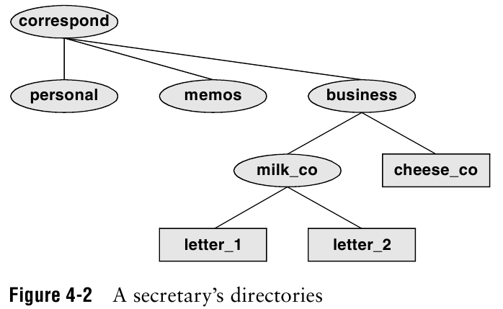

Slide 4
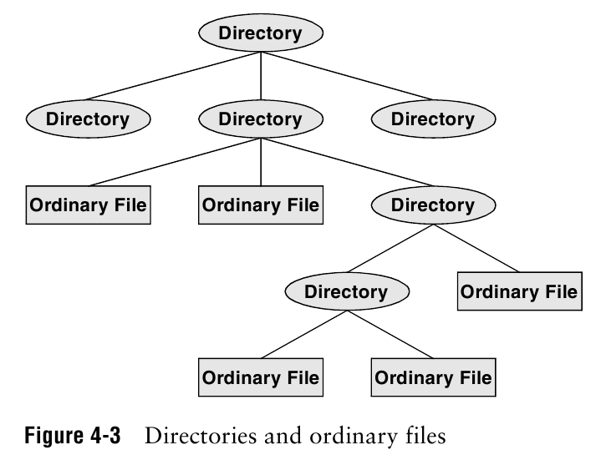
Notes:
Tree representation usually pictured upside down with its root at the top. Either a file or a directory.

Slide 5
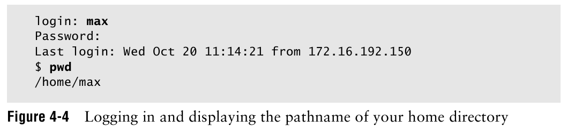

Slide 6
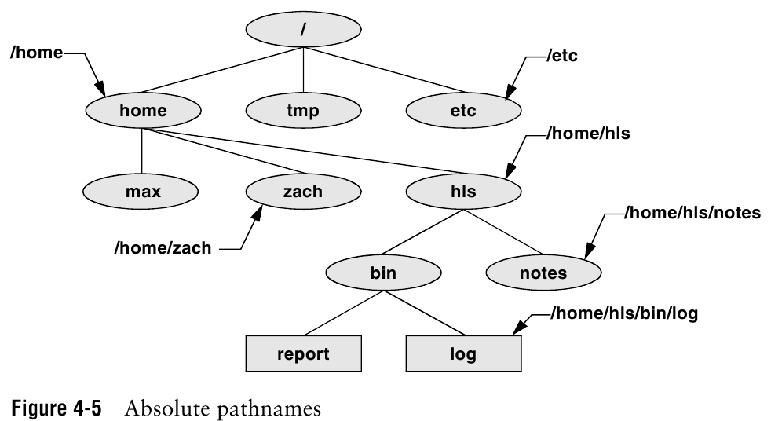
Notes:
Absolute path starts with “/”.
“~” : home directory
“.”: current directory(working directory)
“..”: parent directory

Slide 7
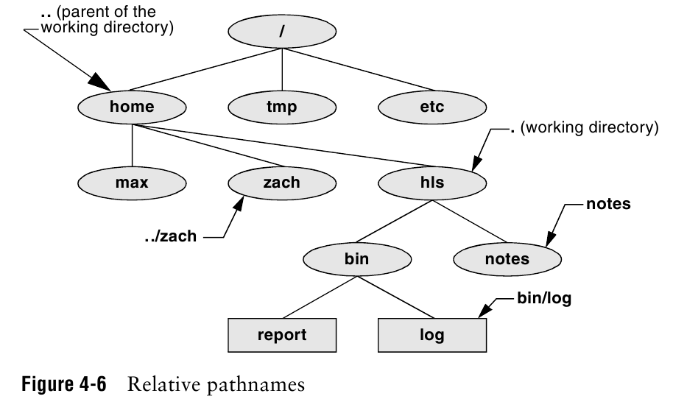
Notes:
Relative path: traces a path from the working directory to a file. The parthname is relative to the working directory.

Slide 8
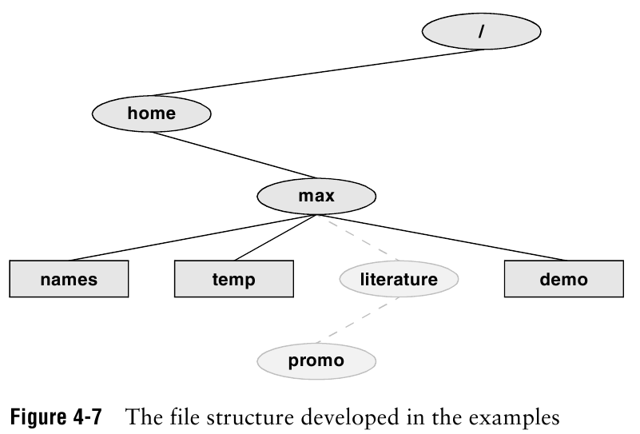

Slide 9
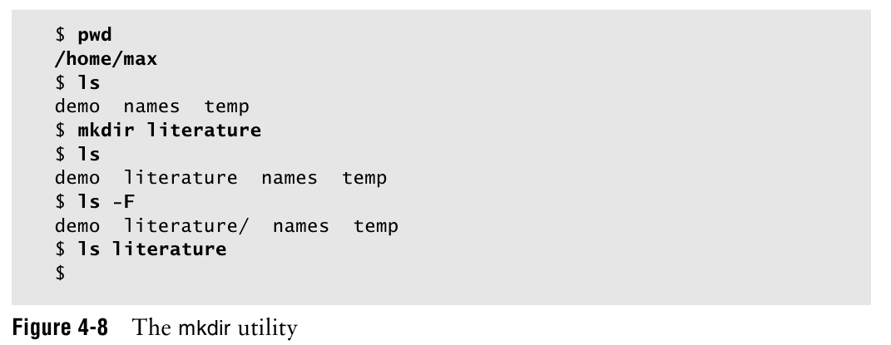

Slide 10
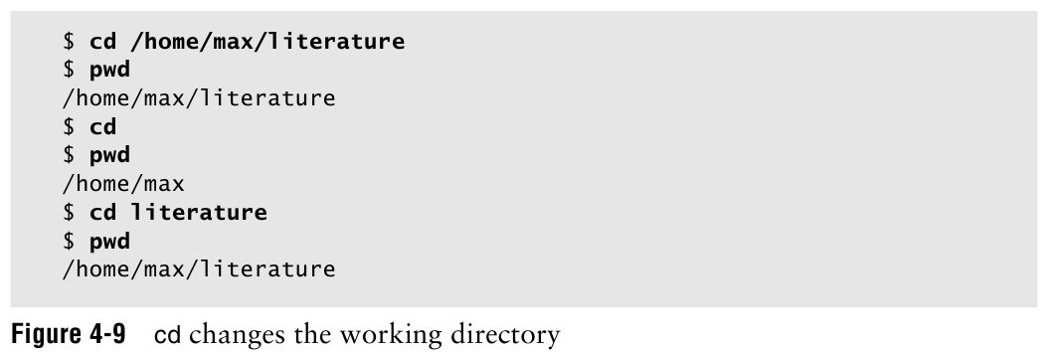

Slide 11
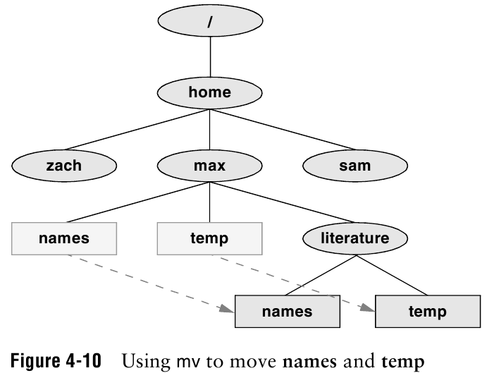
Notes:
rmdir = rm –r
mv, cp : move or copy files
mv: move a directory
If the working directory is : /home/max
Command: mv names temp literature

Slide 12
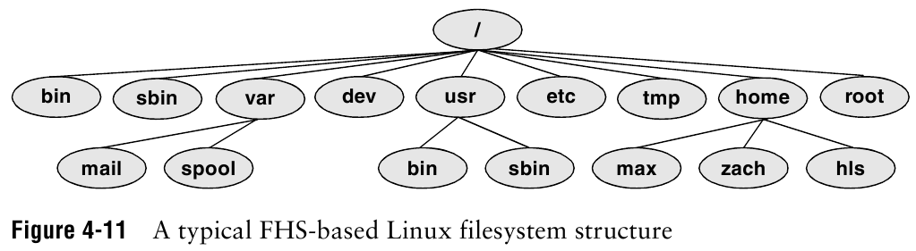
Notes:
Filesystem Hierarchy Standard: / root (the ancestor of all files in the filesystem)
Bin: essential command binaries
Boot: boot loader
Lib:libraries
Etc: configuration
Tem: temporary files

Slide 13
File permissions
Each file in Unix/Linux has an associated permission level
This allows the user to prevent others from reading/writing/executing their files or directories
Use “ls -l filename” to find the permission level of that file

Slide 14
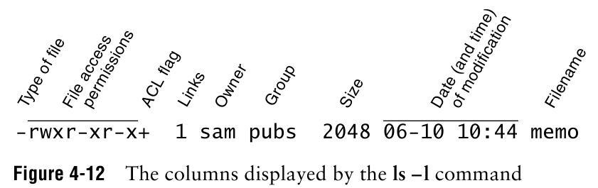
Notes:
ACL: access control list (present if the file has an ACL) provide finer-grained control

Slide 15
Permission levels
“r” means “read only” permission
“w” means “write” permission
“x” means “execute” permission

Slide 16
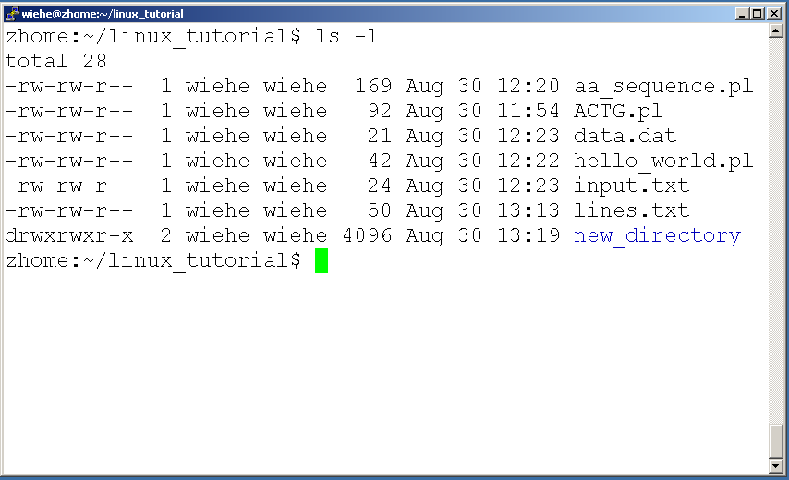
File Permissions
User (you)

Slide 17
File Permissions
Group

Slide 18
File Permissions
Other

Slide 19
Command: Chmod
Changes access permission
u: owner(user) g: group o: other a: all
+: add -: remove
r: read w: write x: execute

Slide 20
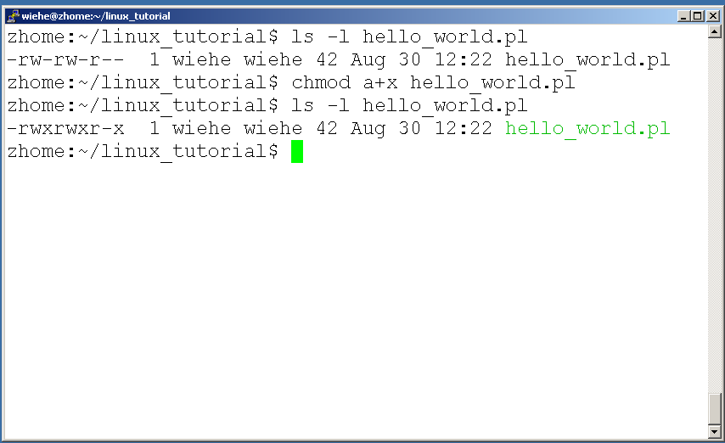
Command: chmod
If you own the file, you can change it’s permissions with “chmod”
Syntax: chmod [user/group/others/all]+[permission] [file(s)]
The right example grant execute permission to all:

Slide 21
Command: Chmod
Symbolic arguments
Numeric arguments

Slide 22
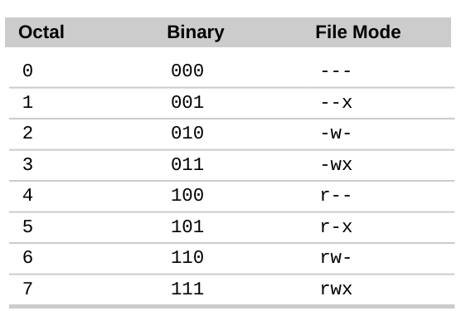
Numeric arguments

Slide 23
Convert “rwxr-x--x” to numeric presentation
rwxr-x--x: 111 101 001 (Binary)
111 (Binary): 7 (octal)
101 (Binary): 5 (octal)
001 (Binary): 1 (octal)
rwxr-x--x: 751 (octal)

Slide 24
Running a program (a.k.a. a job)
Make sure the program has executable permissions
Use “./” to run the program

Slide 25
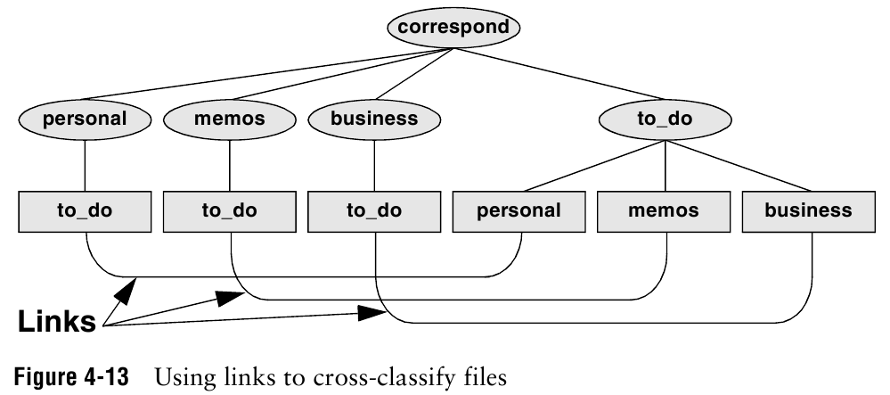
Notes:
A link is a pointer to a file. Each time you create a file using vim, touch, cp. You are putting a pointer in a directory.
You can share your file to other user by creating additional link to the file. (first give permission)
Link is also useful to a single user with a large directory hierarchy.c
All you to-do lists conveniently in one place.

Slide 26
Announcement:
Quiz 2 on Feb 13th in class.
Close book. Close note.
10 - 15 minutes.
Focus on Unix commands and file structure.

Slide 27
In class Lab 3_1 and Lab 3_2:
Using script to capture your work for lab 3_1 and lab 3_2 (ilearn), save it to your lastname_lab3.txt, and send the file in iLearn.

